Slide 1

Stroke data
By: Jeremy McCleary

Slide 2
Data set of victims if they had or had not had a stroke
There are 5,110 people involved in this data ranging in all ages up to 78
Shows the smoking status and other health issues
Can we predict if a person had a stroke based on underlying health issues

Slide 3
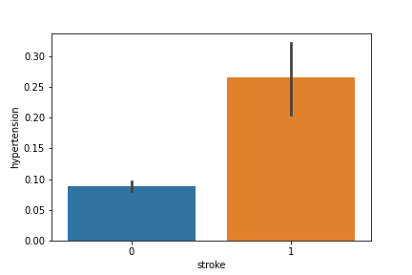
This shows people with higher hypertension have a higher stroke rate

Slide 4
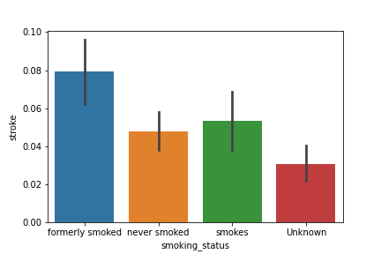
This shows that people who formerly smoked and also still smoke have a higher risk of stroke as well.

Slide 5
Machine learning model used
Type of problem= Classification
Types of models used= Logistic Regression(with and without PCA), KNN(with and without PCA)
Logistic Regression performed best with a .81 f1 score which is very good

Slide 6
Recommendations
Less smoking of course
Decreasing your BMI(aka exercising and doing other physical activities)
Can’t decrease your age but doing the two first things will help decrease your chances of getting a stroke

